Slide 1
Career Counselling System using Machine Learning
Name: Swasti Bhutani
Enrollment no.:36614803118 Group:8I6

Slide 2
Introduction
Competition these days is heavily multiplying every moment. So, one needs to be aware, planned and organized in their initial stages of education. Constant evaluation and assessment can help one choose the right career path for themselves.

Slide 3
Career Counselling using ML
My project considers various factors such as technical abilities, hobbies, academics, interests, competition skills, knowledge etc and suggests the right career path to engineering students.
It uses advanced ML algorithms for classification and prediction like SVM, Decision Tree, OneHot encoding, XG Boost etc to evaluate the factors mentioned above mathematically and suggests the best suited job profile for the student.

Slide 4
Process Flow Diagram of proposed system
Data collection
Data Pre-processing
SVM
Data Encoding
Decision Tree
Program Boosting
Training and Testing
Result

Slide 5
Data Preprocessing
Collecting the data is one task and making that data useful is another vital task. Data collected from various means will be in an unorganized format and there may be lot of null values, invalid data values and unwanted data. Cleaning all these data and replacing them with appropriate or approximate data and removing null and missing data and replacing them with some fixed alternate values are the basic steps in pre processing of data

Slide 6
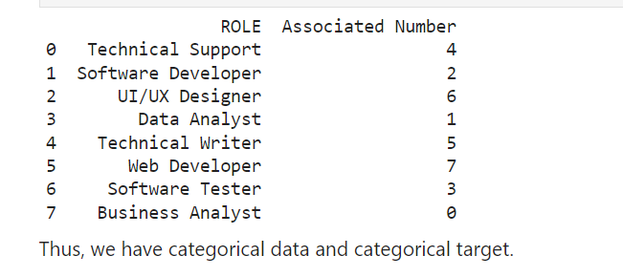
OneHot Encoding
OneHot Encoding is a technique by which categorial values present in the data collected are converted into numerical or other ordinal format so that they can be provided to machine learning algorithms and get better results of prediction. It makes representation of categorial variables to be more expressive.
OneHot Encoding

Slide 7
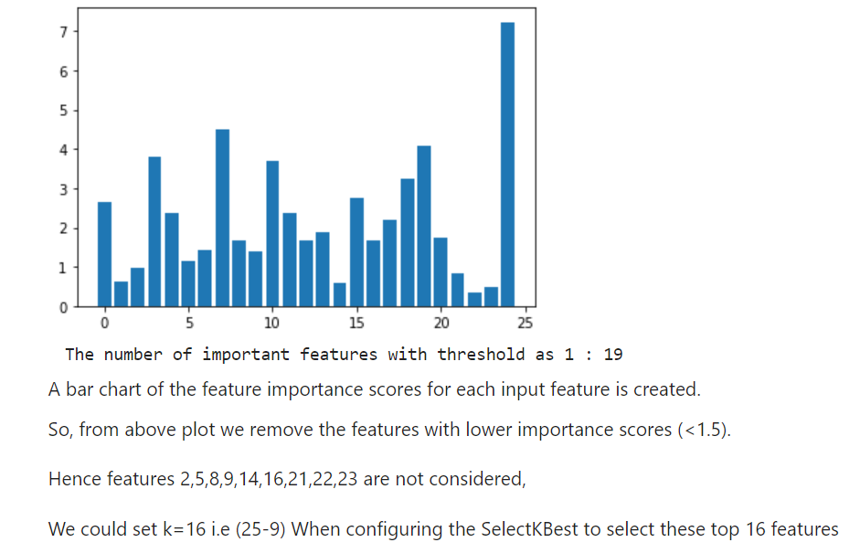
Feature Selection
A feature is an attribute that has an impact on a problem or is useful for the problem, and choosing the important features for the model is known as feature selection.
Feature selection is a process of automatically or manually selecting the subset of most appropriate and relevant features to be used in model building.

Slide 8
Data Classification
Classification in machine learning and statistics is a supervised learning approach in which the computer program learns from the data given to it and make new observations or classifications. It is a process of categorizing a given set of data into classes.
It can be performed on both structured or unstructured data. The process starts with predicting the class of given data points. The main goal is to identify which class/category the new data will fall into.
We have used advanced machine learning algorithms like SVM(Support Vector Machine) and Decision Tree for classification of data.

Slide 9
OneHot Encoding
Boosting is an ensemble learning technique that uses a set of Machine Learning algorithms to convert weak learner to strong learners in order to increase the accuracy of the model.
We have used XGBoost algorithms to boost the efficiency and performance of SVM and Decision tree algorithms.
Program
Boosting

Slide 10

Future Scope
Today’s industry’s demands are dynamic and to meet the same there are new opportunities coming faster than ever. People might not be aware of the latest fields open for recruitment, on the other hand, an ML based Career Counselling system can easily incorporate the information about the new career options open for students. It can be a cost efficient and unbiased substitute to counsellors that can help the young engineering students.

